Slide 1


MAJOR SUBJECTS OF 2025-2, VMC

Slide 2

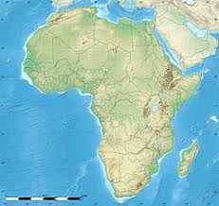
Established to train and dispatch overseas missionaries and missionary church workers for Africa, VMC will offer training in the following key subjects in the 2025-2 semester:
1. Subjects: DTS (Discipleship Training School), DMS (Discipleship Mission School)
2. Period: September 29 (Mon) - November 16 (Sun) (6 weeks) (Nakawuka Campus)

Slide 3
3. DTS (Discipleship Training School)
Objectives
The aim of this course is to enable learners to; acquire knowledge and skill of the discipleship training, practice it in daily life, and help to nurture and train them to be disciples of Jesus Christ
. Ephesians 4:12, ‘to equip his people for works of service, so that the body of Christ maybe built up’
. 2 Tim 2:2, ‘And all things you have heard me say in the presence of many witnesses entrust to reliable people who will also be qualified to teach others’
. Mt 28:19-20, ‘Therefore go and make disciples of all nations, baptizing them in the name of the Father and of the Son and of the Holy Spirit, and teaching them to obey everything I commanded you’.

Slide 4
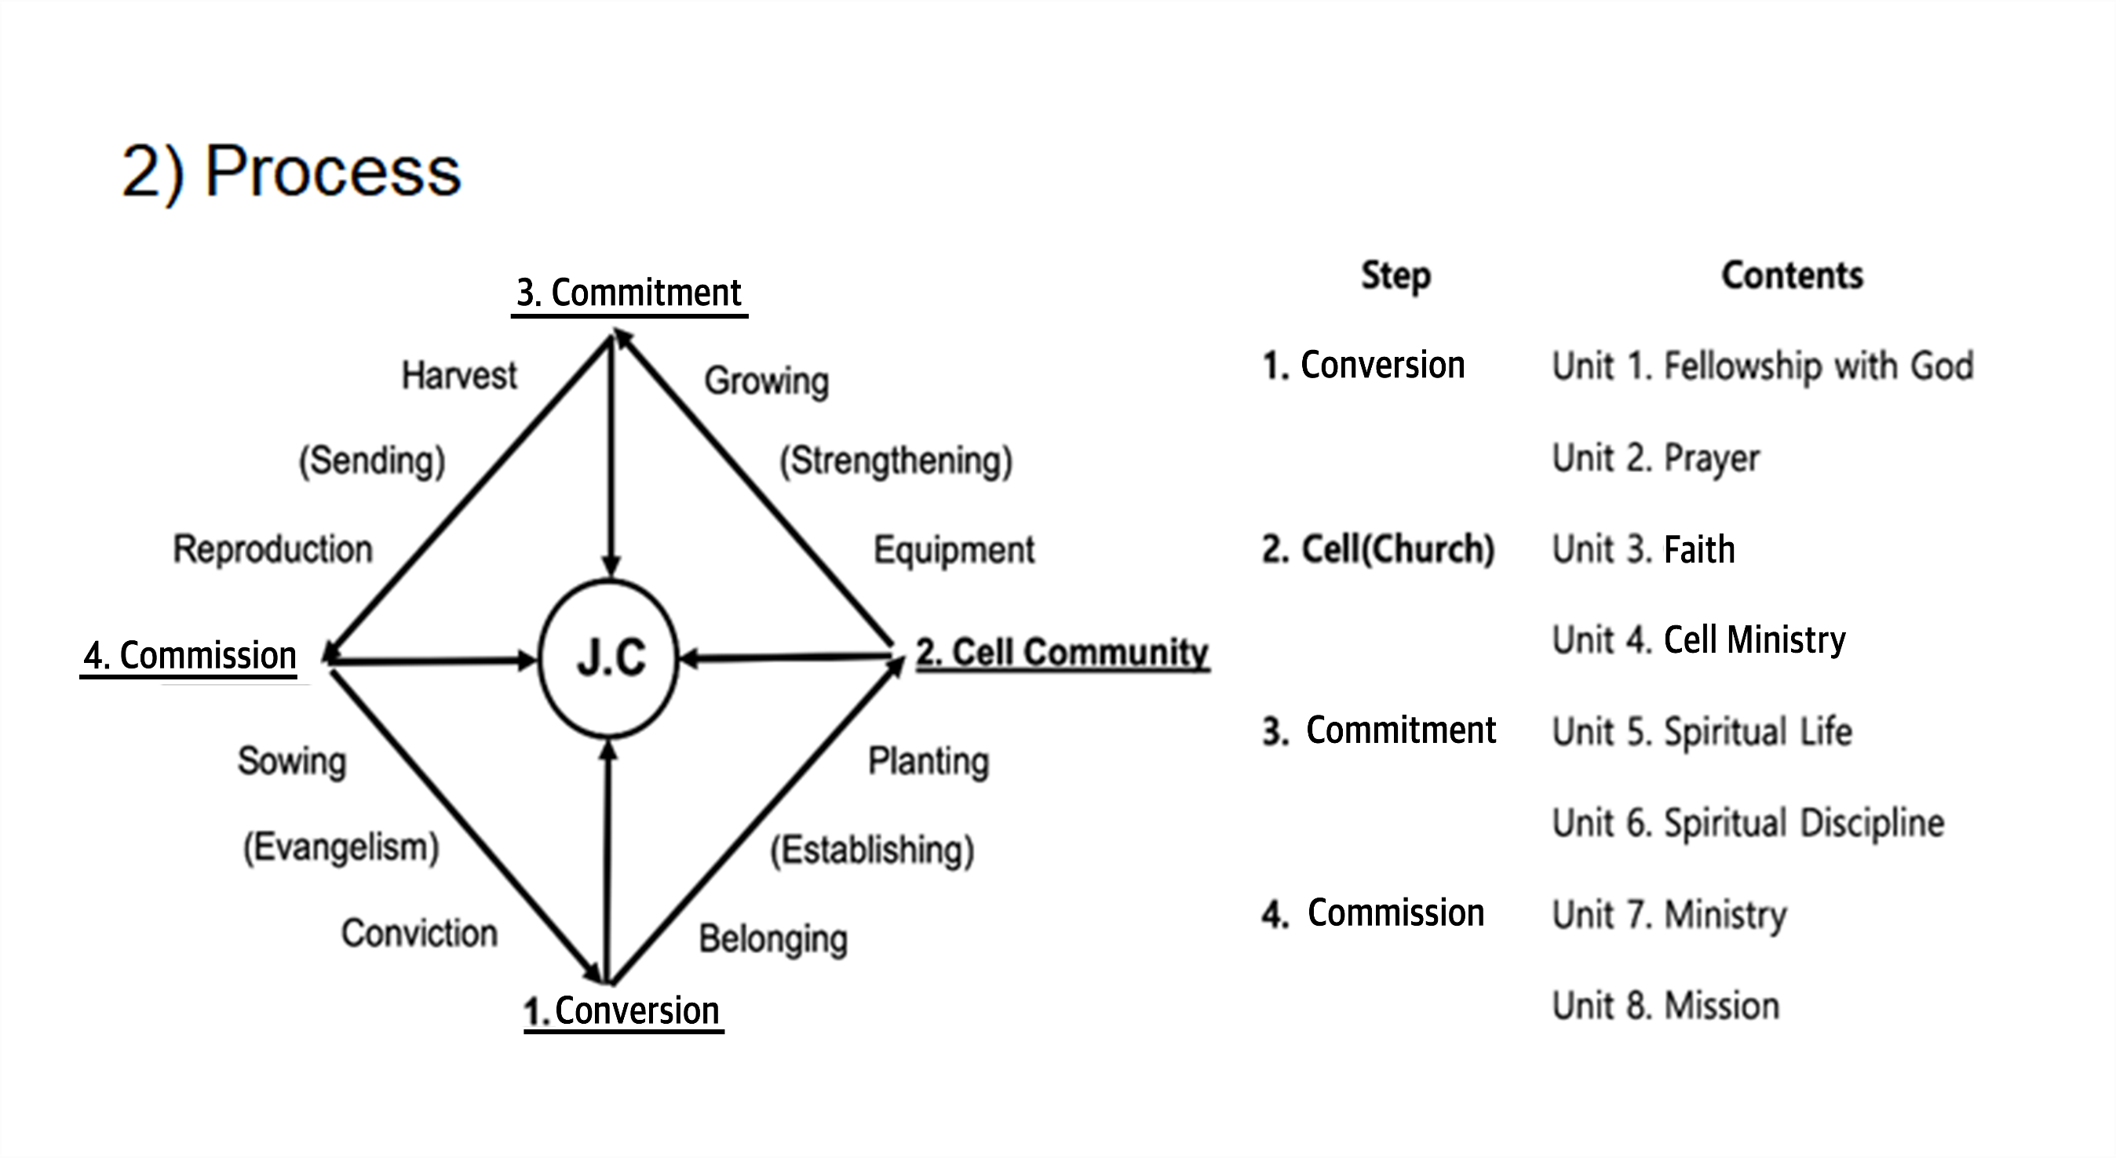

Slide 5
3) Contents
Stage | Purpose | Unit | Contents
Conversion | Establishing a basic relationship with God through fellowship and prayer | 1. Fellowship | Habituation of a Basic Relationship with God
 |  | 2. Prayer | Preparation and Practice of Prayer
Community | Basic belief in Christ and belonging to the church community | 3. Faith | Basic Faith through Gal 2:20
 |  | 4. Cell Community | Belonging to Church community and small groups
Commitment | Discipleship of the personal and communal life for commitment to Christ | 5. Spiritual Life | Disciple's personal and spiritual life training
 |  | 6. Spiritual Discipline | Relational and communal life training
Commission | Missional practice for the reproduction of discipleship and world mission | 7. Ministry | Pastoral leadership through Nehemiah
 |  | 8. Mission | Practical Training for Mission

Slide 6
4) Curriculum
Unit 1. Fellowship with God | Unit 2. Prayer | Uni1. 3. Faith | Unit. 4 Cell Ministry
1. Introduction to Discipleship Training 2. Fostering Spiritual Habits 3. Reading the Bible 4. Quiet Time (Q.T) 5. Memorizing Scripture 6. Spiritual Journal (S.J) | 1.Jesus Prayer 2. Discerning the Will of God 3. Preparation of Prayer 4. Practice of Prayer 5. Intercession Prayer 6. Spiritual Warfare | 1. Christ , the Center 2. Jesus was crucified 3. I have been crucified with Christ 4. I live In the body 5. I die every day 6. Repentance and Baptism | 1. What is Cell Church? 2. Cell Meeting 3. How to lead a small group? 4. Cell Evangelism 5. Multiplication of Cell Group 6. Cell Leadership

Slide 7
Unit 5. Spiritual Life | Unit 6. Spiritual Discipline | Unit 7. Ministry | Unit 8. Mission
Worship Hearing the voice of God Meditative Prayer Work and Walk Obedience Stewardship | 1. Marriage and Family 2. Sex and Body 3. Money and Simplicity 4. Power and Service 5. Temptation and Suffering 6. Idolatry and Heresy | 1. Church Ministry 2. Spiritual Gifts 3. Team Leadership (Nehemiah) 4. Pastoral Ministry (Timothy) 5. Discipleship and coaching 6. Church Growth and Kingdom (Acts) | 1.Called to Mission 2. Abraham: Calling to Mission 3. Zechariah, Vision for Mission 4. John the Baptist 5. Phillip, Missional Life 6. Missional Church Ministry

Slide 8
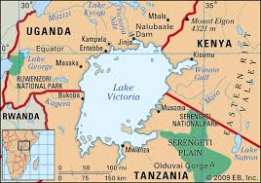
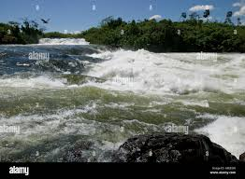
4. DMS(Discipleship Mission School)
Objectives
Based on the biblical and theological driving force of missions, this course trains students in the methods and skills necessary for ministry in the mission field and helps them develop mission strategies tailored to the field.

Slide 9
2) Subjects
3S | Main directions | Main Subjects
Spirit | Providing a common foundation for missions through the Bible, theology, and mission history. | DTS, Missional Reading of the Bible, Paul’s Mission, Theology and Strategy, Theology of Mission, History of Mission, Mission and Holy Spirit, Missional Church, Theological Trends of World Mission
Skill | Research on missionary methods and skills that can be implemented concretely in the mission field | Evangelism, Church Planting, Cell Ministry, Discipleship Training, Pastoral Leadership, Conflict and Communication, Team Mission, Pastor’s Life and Spirituality, Worship, Family and Children education, Preaching and Counseling, Church education for children and adults
Strategy | Studying mission strategies and directions according to global and local mission situations. | Global and local situation and perspectives of Mission. Indigenization in African Mission, Mission in African Context, African Culture and Mission

Slide 10
5. Lecturers
Expert lecturers serve according to the topic of the lecture.
. Dr. Paul Lee (Bible and Discipleship Training)
. Dr. James Lee (Family and Spirituality Training)
. Dr. D.H. Shin (Mission Practice and Field)
. Prof. T.Y. Choi (Mission Theology and History)
. Dr. E.J. Shin (Church Education for Children and Y
outh)
. Rev. Christopher (Mission in the African Context)

Slide 11

Prayer Request
. Please pray once a day for VMC and the second semester lectures.
. Please pray for Dr. Paul and the lecturers.
. Please pray that many African students (and pastors) with passion and vision for
missions will participate, and that much African missions will bear fruit through VMC.

